Slide 1
UIT2502– DATA ANALYTICS AND VISUALIZATION
HEALTH CARE
BY
PAECHIAMMAL GANDHI -3122 21 5002 075
SAI HARSHITH - 3122 21 5002 076
POOJA V - 3122 21 5002 077

Slide 2
PROBLEM STATEMENT
Healthcare:• Data science is used to analyze patient data, including medical history, test results,and lifestyle factors. It also helps inidentifying patterns and trends in medical data for research and treatment optimization

Slide 3
DATA COLLECTION
Strengths of the dataset:
Controlled Environment:Simulation and collaboration with institutions allow for control over the data collection environment, ensuring adherence to ethical standards and privacy regulations.
Flexibility:Simulated data and collaboration offer flexibility in generating diverse scenarios, enhancing the dataset's breadth.

Slide 4
DATA COLLECTION
Limitations of the dataset:
Lack of Real-world Variability:
Simulated and collaboratively collected data might lack the full variability and complexity of real-world healthcare scenarios.
Ethical and Privacy Concerns:
Even with simulated data, ethical considerations and privacy concerns must be addressed. Real patient data must be handled with extreme care to comply with regulations.

Slide 5
CENTRAL TENDENCY
data.describe() method is used to generate descriptive statistics that summarizes the central tendency,dispersion,shape of dataset distribution.
It also gives implications of central tendency(interpreting model’s predictions) and variability(interpreting the stability and reliability of model’s predictions ).

Slide 6
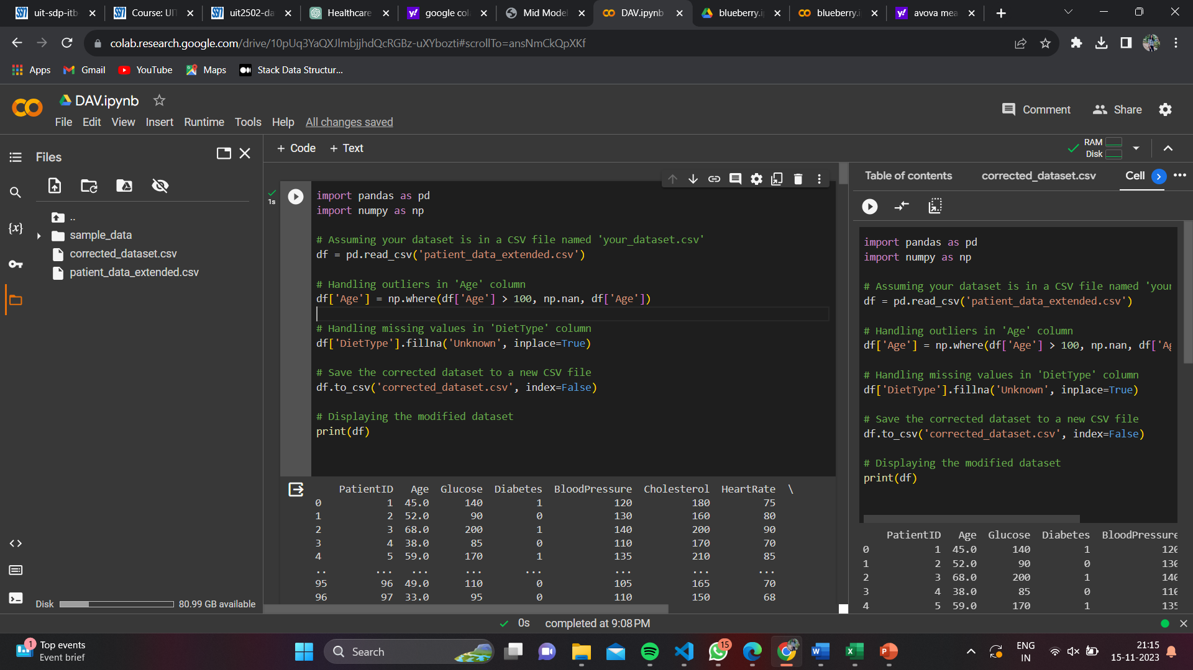
DATA PREPROCESSING
Handling missing values
The missing values in the feature are replaced by mean value.
In case if the feature is not normally distributed or has outliers then replace missing values with median value as mean tends to deviate due to the presence of outliers.

Slide 7
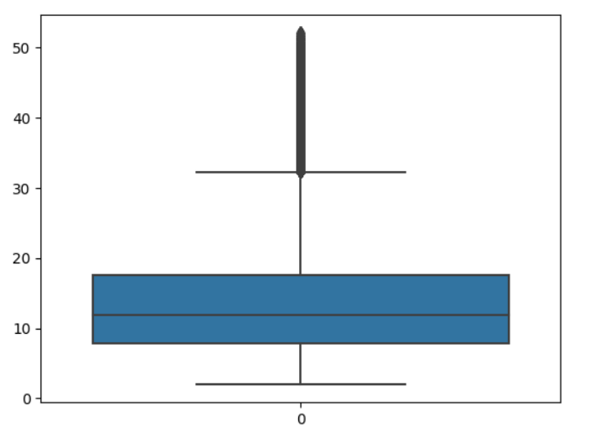
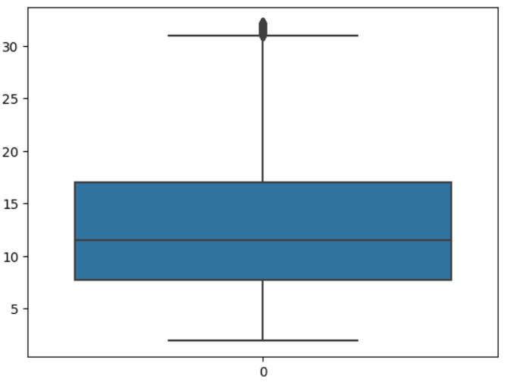
DATA PREPROCESSING
Before handling outliers After handing outliers

Slide 8
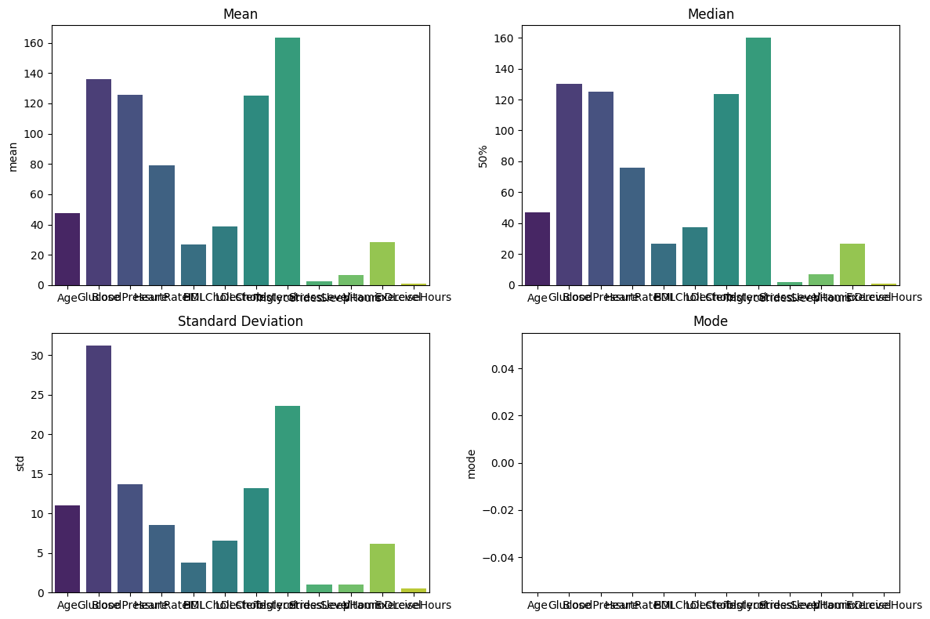
MEAN, MEDIAN, MODE
A collection of observations produced by sorting observations into classes and showing their frequency of occurrence in each class.

Slide 9
CORRELATION
Pearson Correlation Coefficient: Measures the strength and direction of linear relationship.
  When the value is closer to +1 - Strong and Positive relationship
  When the value is closer to 0 - Weak or no Linear relationship
  When the value is closer to -1 - Strong and Negative relationship

Slide 10
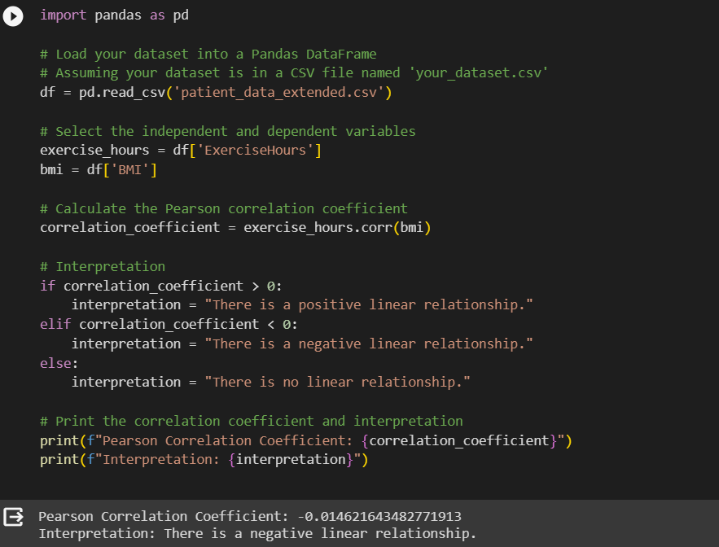
CORRELATION

Slide 11
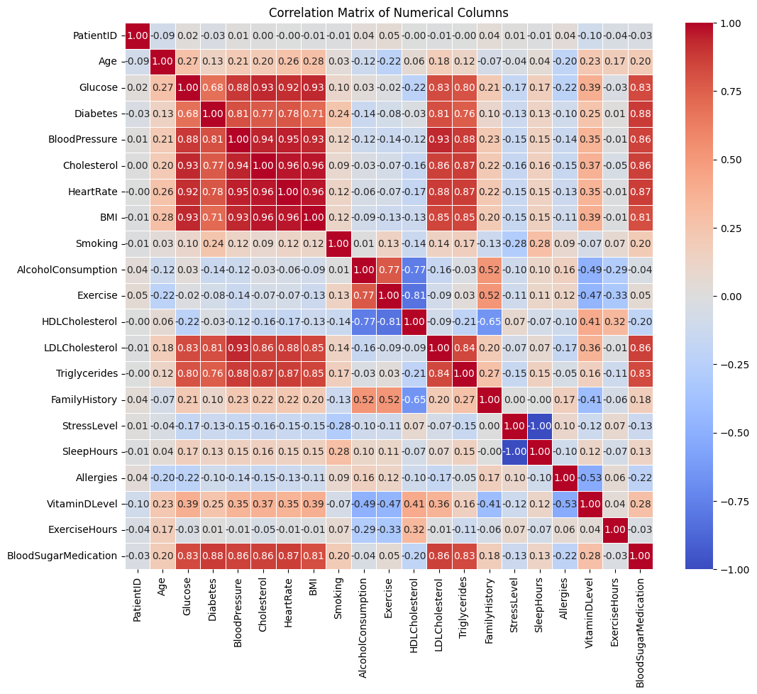
CORRELATION MATRIX

Slide 12
Z- test
Assumptions:
Normal Distribution: The data should follow a normal distribution.
Random Sampling: Data should be collected to ensure sample is a representative of population.
Limitations:
Population Standard Deviation: In case if it’s not known leading to use of sample standard deviation.
Small Sample Size: When sample size (n<30) z-test won’t be appropriate.

Slide 13
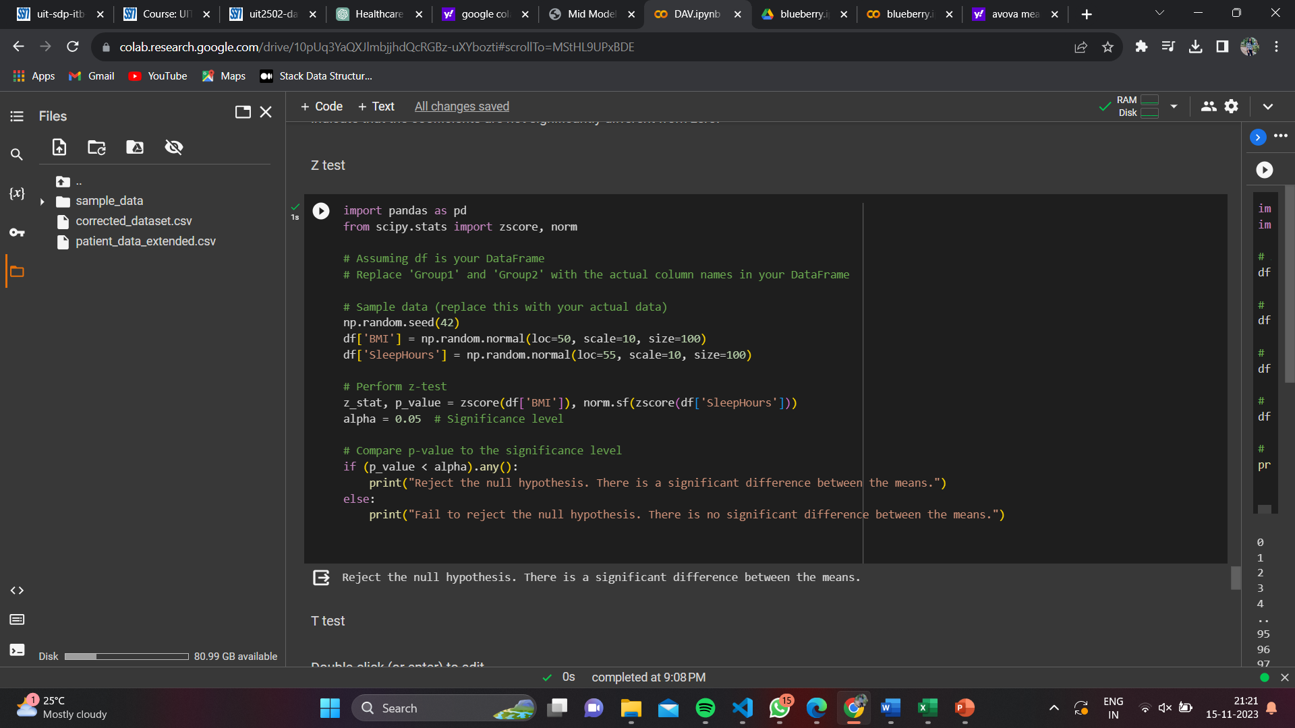
Z -test
It is used when sample size is large and population standard deviation is known.
We have p_value>=0.05, we accept the hypothesis

Slide 14
T - test
A statistical method used to determine if the is a significant difference between mean of two groups.
We have p_value>=0.05, we accept the hypothesis.
Assumptions:
Normal Distribution: The data should approximate a normal distribution.
Homogeneity of Variances: Variances within each group should be approximately equal.
Limitations:
Sensitive to Assumptions: Violation from normality and variances might lead to inaccurate results.

Slide 15
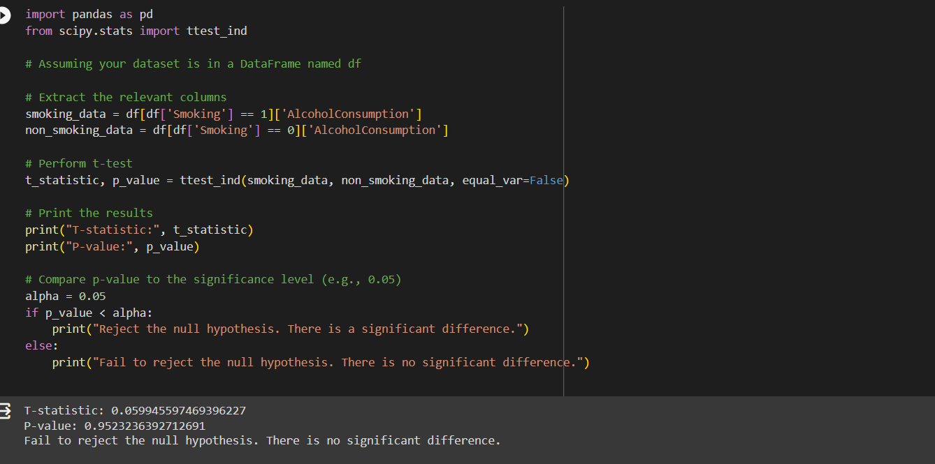
T - test
Here, we compare the 2 independent groups alcohol consumption and smoking

Slide 16
ANOVA
Assumptions:
Normal Distribution: The data should approximate a normal distribution.
Homogeneity of Variances: Variances within each group should be approximately equal.
Random Sampling: Data should be collected to ensure sample is a representative of population.
Limitations:
Sensitive to Assumptions: Violation from normality and variances might lead to inaccurate results.
Equal Sample Sizes: ANOVA works best only sample sizes are equal.
Unequal sample sizes may affect accuracy.

Slide 17
ANOVA
Analysis of Variance is a statistical method used to compare the means of three or more groups to determine if there are statistically significant differences between them.
Here, we compare randomly picked from 3 independent groups.
We have p_value>=0.05, we accept the hypothesis.

Slide 18
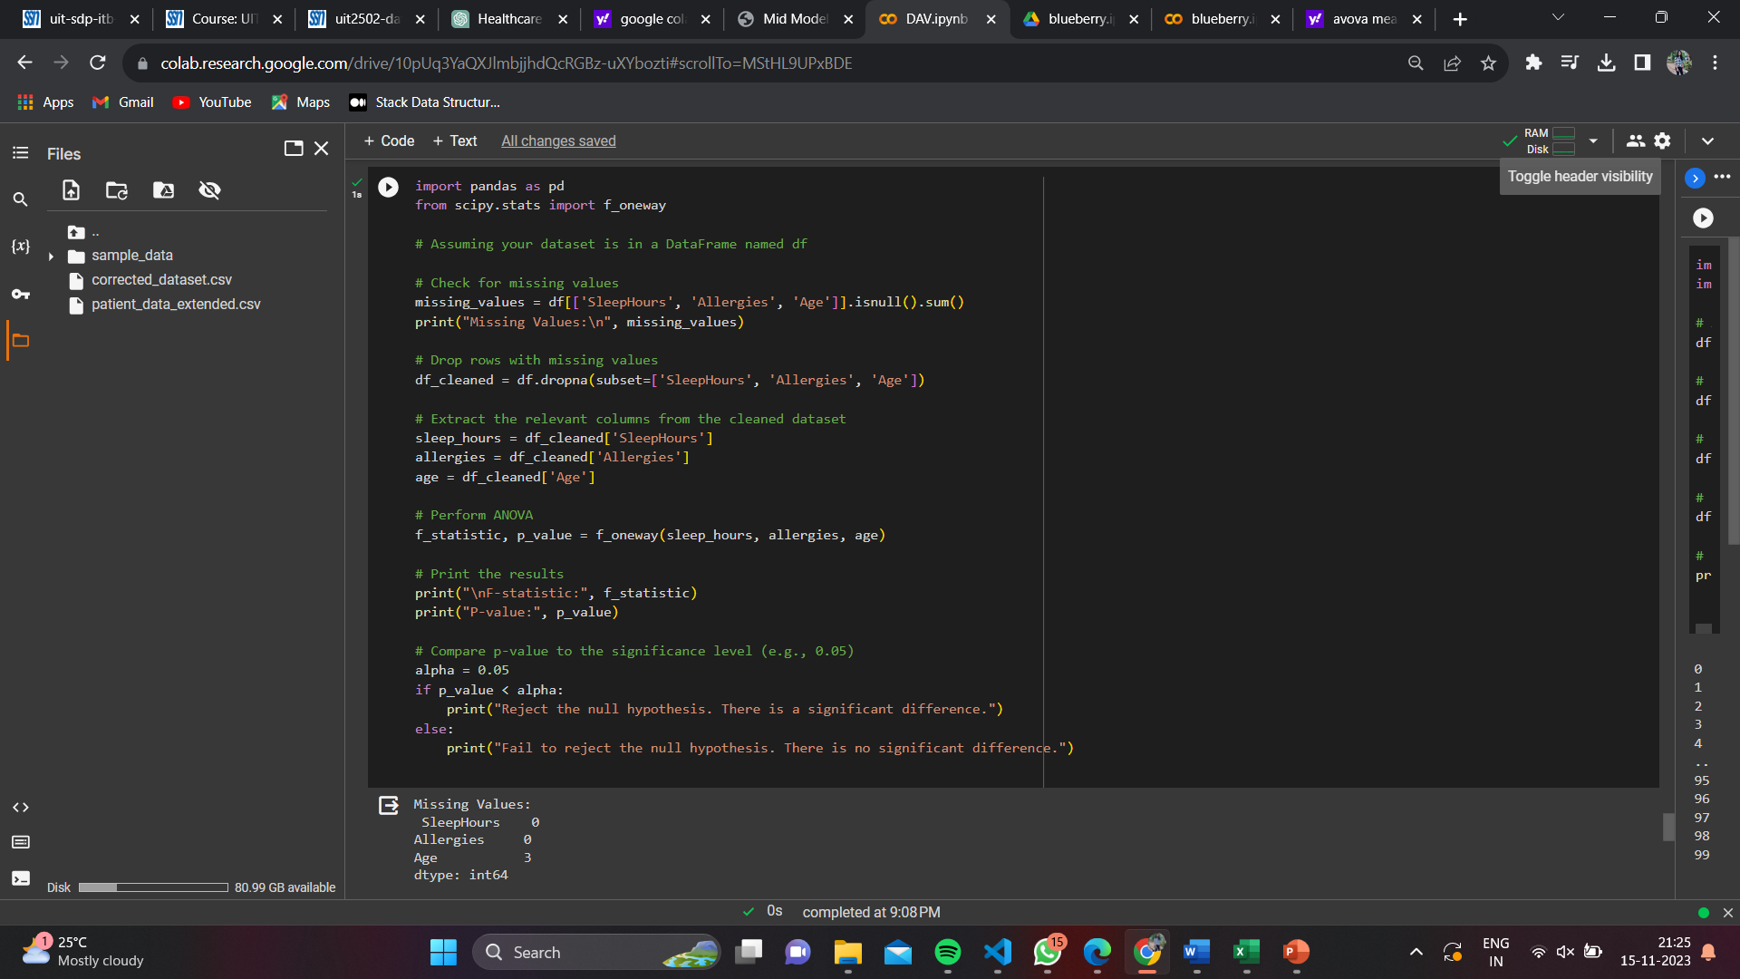

Slide 19
REGRESSION
Set up a target variable/dependent variable.
Set up the features(independent variables) that determine the target.
Use 70% of datapoints to train the model and rest 30% of datapoints to test the model.
Calculate the Mean-Square-Error and R^2 value of the linear regression model built to validate the model.

Slide 20
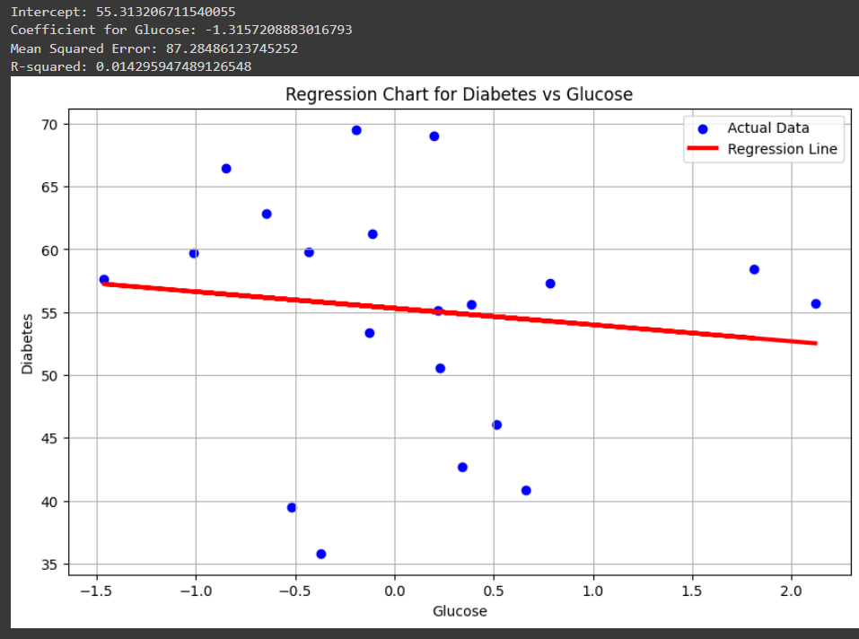
REGRESSION

Slide 21
INFERENCES
According to the analysis done with the taken dataset, we have inferred that
  We have a negative correlation between ExerciseHours and BMI.
  We have a positive correlation between Glucose and Diabetes.

